Slide 1

The sustainability of electricity market in the
Czech Republic and Austria
Žiga ČERPES & Karel TEZNER
Czech-Austrian Winter and Summer School
Co-operating universities
Financial supprot by

Slide 2
Introduction
The sustainability of electricity market in the
Czech Republic and Austria
Electric energy supply
Potential energy shortages
Future alternatives
Conclusion

Slide 3
AUSTRIA
Electric energy supply
Energy final demand of electricity 2009 | in GWh
Gross electricity production | 68.974
+ Electricity imports | 19.542
= Electricity application | 88.516
- Electricity exports | 18.762
- Pump storage | 3.961
= Domestic electricity consumption | 65.793
- Own usage | 1.842
- Network losses | 3.520
= Final energy demand | 60.431

Slide 4
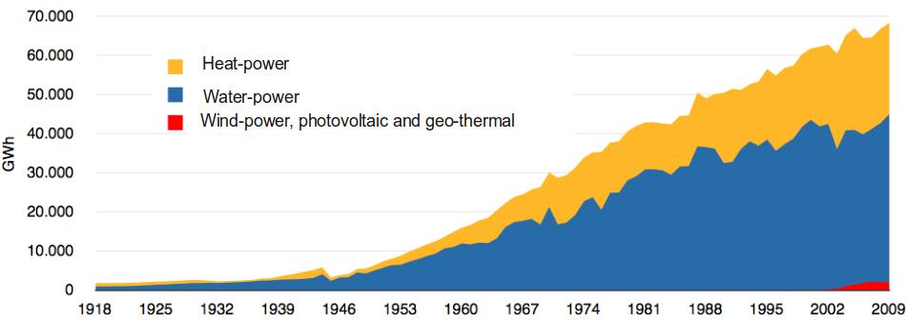
AUSTRIA
Electric energy supply
Austria, one of the „greenest“ electricity producing country

Slide 5
AUSTRIA
Potential energy shortages
e-Control identifies 4 main factors which cause blackouts:
Atmospheric impacts: Storms, ice, snow, avalanches, humidity, temperature, earthquakes, etc.
External impacts: through people, animals, cranes, vehicles, fire or through other factors induced disturbances.
Network operator intern: Switching errors, blackouts, ageing, overloads, etc.
Supply failure/backlash disturbances: outfall of upstream voltage level, outfall of power supply (from the producer) or from disturbances from other networks that have retroactive impacts.

Slide 6
AUSTRIA
Potential energy shortages
Approximately 10.000 shortages per year
One hour blackout in Austria would cause damages in the amount of 40 Mio €
61% of interruptions are planned interruptions
47% of unplanned interruptions caused by atmospheric influences (without natural disasters), 20% by foreign influences and the rest by network operators
Prevention of blackout via structural and overall security, regionally equalized generation quotas, operational capability, measures for limiting the consequences

Slide 7
AUSTRIA
Future perspectives and conclusion
The 2020 target for Austria is to cover 34% of total energy demand with renewable energy (24% in 2007)
At the moment, Austria records 18% losses of total energy supply via transformation and distribution of energy supply
Austria produces around 75% of its energy via renewable energy sources
Relatively strong dependence on atmospheric influences
the security of supply is almost 99%
Actual feasibility of reaching 2020 targets? – first step: optimize consumption?

Slide 8
THE CZECH REPUBLIC
Electric energy supply
Czech energy sector - basic overview
Indicator | 2010
Installed capacity (MW) | 20 073
Gross electricity production (GWh) | 85 910
Gross electricity consumption (GWh) | 70 962
Electricity imports (GWh) | 6 642
Electricity exports (GWh) | 21 591

Slide 9
THE CZECH REPUBLIC
Electric energy supply
Gross energy supply in the Czech Republic (GWh)
Indicator | 2010 | 2009 | ∆ 2009/2010
 | 85 910 | 82 250 | 4,45%
Fossil fuel power plants | 49 979,70 | 48 457,40 | 3,14%
Hard coal upgrading processess | 6 043,60 | 5 310,80 | 13,80%
Brown coal and Lignite upgrading processess | 40 907,40 | 40 361,60 | 1,35%
Others | 3 028,70 | 2 785,00 | 8,75%
Gas power plants | 3 600,40 | 3 225,20 | 11,63%
Hydroelectric power plants | 3 380,60 | 2 982,70 | 13,34%
Nuclear power plants | 27 998,20 | 27 207,80 | 2,91%
Wind power plants | 335,5 | 288,1 | 16,45%
Photovoltaic power plants | 615,7 | 88,8 | 593,36%

Slide 10
THE CZECH REPUBLIC
Potential energy shortages vs. alleged slack of brown coal
Nearly half of the total production of electricity is generated through brown coal and lignite upgrading processes.
75 % of heat is produced via the central cogeneration (combined heat and electricity generation).
1,48 millions of households are supplied with heat from district heating.
According to the credible analyses (e.g. one conducted by the Ministry of Industry and Trade of the Czech Republic) the slack of 5 - 6 mil. tonnes of brown coal might allegedly occur in the forthcoming years.
A prospective deficiency might cause significant increase in prices of heat and electricity and so that creates negative pressure on household budget.
Considerable amount of brown coal is forbidden because of the mining limits.
Pressure of mining companies on raising the mining limits.

Slide 11
THE CZECH REPUBLIC
Future alternatives
Planned power plants
Location | Type of plant | Charakteristic | Installed capacity | Time framework
Počerady | gas power plant | new source | 838 MW | - under construction - starting-up 06/2013
Mochov | gas power plant | new source | 1000 MW | - negotiations are in progress
Temelín | nuclear power plant | enlargement | 2000 MW | - date of realization: 2020-2025
Dukovany | nuclear power plant | enlargement | 1500 MW | - feasibility study
Blahutovice | nuclear power plant | new source | N/A | - no sooner than 2040
Diminish dependancy on brown coal in the LR

Slide 12
THE CZECH REPUBLIC
Conclusion
The alleged slack of brown coal does not exist.
There is no objective necessity to raise the minig limits.
The state should play a vital role as a regulator.
Other challanges need to be solved:
Improvements of national energy framework
Stringent emmision limits (from 2016)
EU green policies
Prospective covering of German nuclear shutdown
Long-term point of view needs to be applied.

Slide 13


